Slide 1
Sampling Time 1
Sampling Time 2
Sampling Time 3

Slide 3
Sampling Time 1
Sampling Time 2
Sampling Time 3

Slide 4
April 2022 figure recreate
Use these for paper

Slide 5
16S

Slide 6
a *
a *
a *
a *
a *
a *
b *
b *
a *+
a *
a *
a *
a *
a *+
ab *
b *
ab +
ab *
a *
ab *
b *
a +
ab *
a *

Slide 7
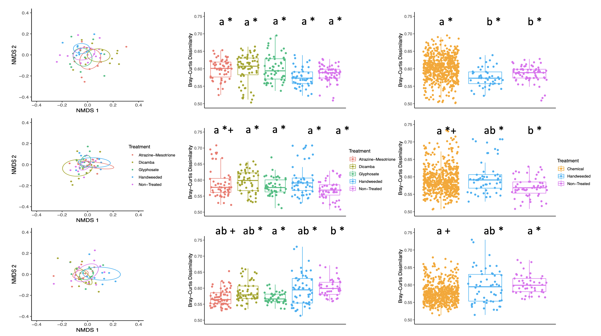

Slide 8
ITS

Slide 10
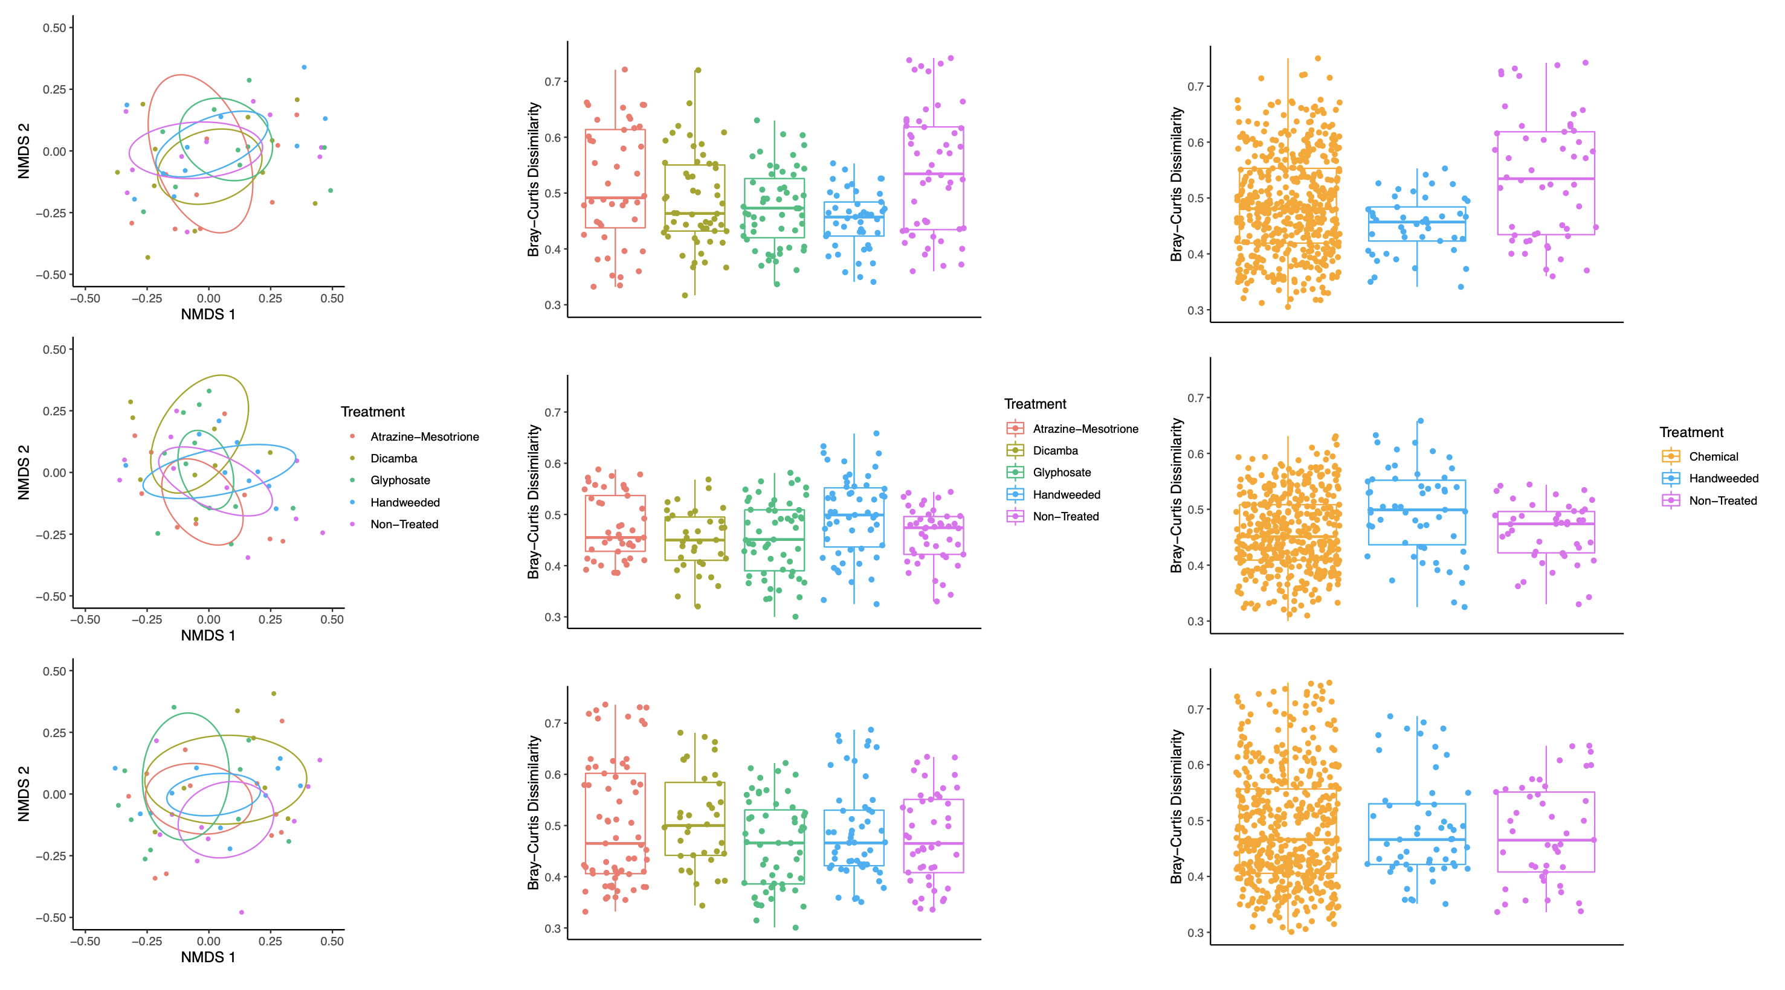

Slide 11
a
b
ab
a
b
ab
a
b
ab
a
b
ab
a
b
ab
ab
b
a

Slide 12
